Slide 1
Learning Management System
Presented By:
Muhammad Younas
BSIT-20-42
Supervised By:
Dr. Maruf Pasha

Slide 2
Project Introduction
Students need quick and easy access to a wide range of academic and administrative services. The Learning Management System application is designed to meet this need by providing a comprehensive, user-friendly platform for students in educational institutions. With this system, users can easily create and manage their accounts. Secure login and authentication ensure that user data remains protected. In case users forget their passwords, they can reset them with ease.

Slide 3
Key Features
User Management:
The system shall allow the users to create their accounts with email.
The system shall allow the user to securely login to their accounts.
Course Management:
Users can add different courses to the system.
Users can update or modify information for selected courses.
User Profile Management:
The system shall maintain a user profile and display all necessary information.
The system shall allow the user to update his/her profile.

Slide 4
Key Features (Continued)
Fee Management:
System should Maintain detailed records of each student's fee payments, including due dates, amounts paid, and outstanding balances.
Mobile-Based Application :
The application is accessible through mobile devices with internet connectivity.
Basic mobile device usage skills are required to navigate the application.

Slide 5
Objectives
User-Friendly Interface
Accessibility and convenience
Offline access to content
Seamless integration with other educational tools
Secure data management
Admin efficiency

Slide 6
Language Used
This project is developed using modern flutter technology like Dart. This language is used for both frontend and backend development and follows the best practices in software development to ensure reliability, security and user satisfaction.

Slide 7
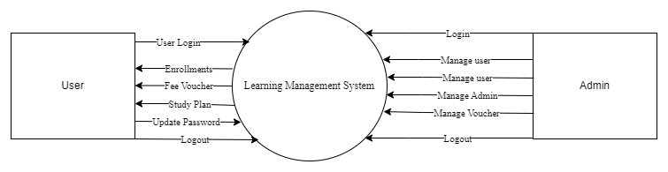
Data Flow Diagram
Level 1 DFD:

Slide 8
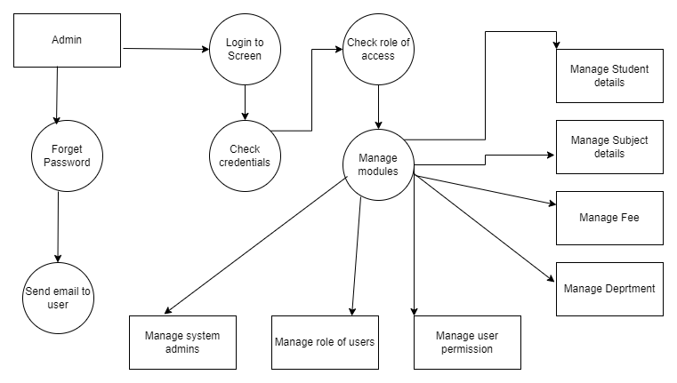
Level 2 DFD

Slide 9
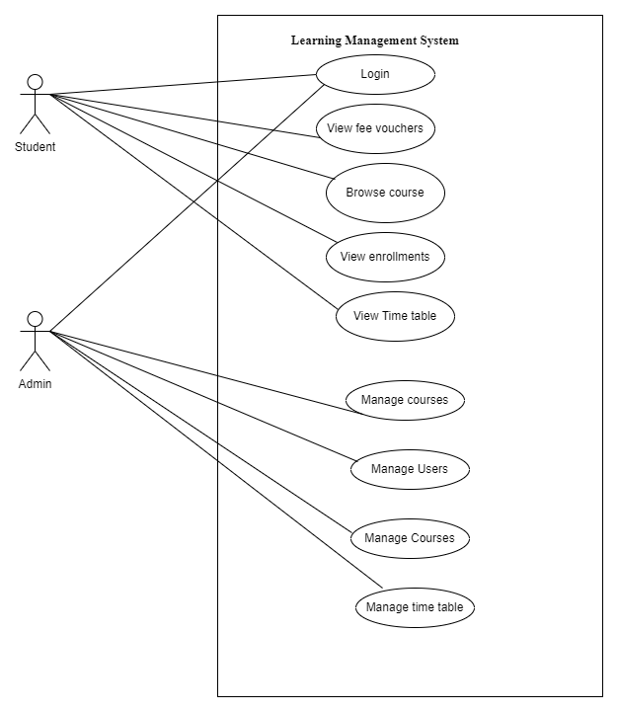
System Design
Use Case Diagram

Slide 10
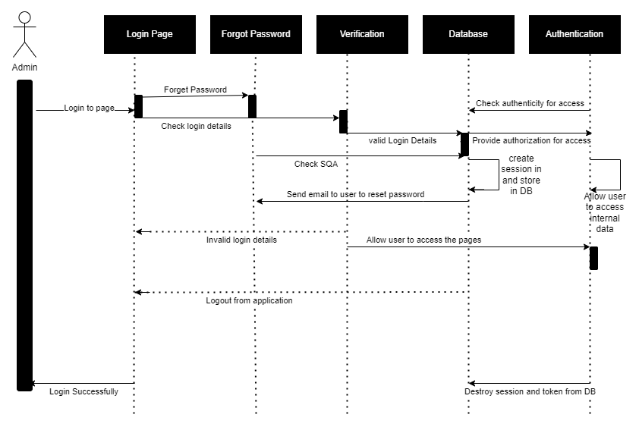
System Design
Sequence Diagram Login

Slide 11
User’s Guide

Slide 12
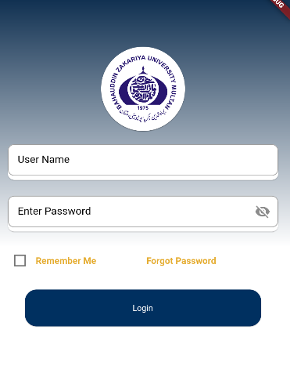
User’s Login

Slide 13
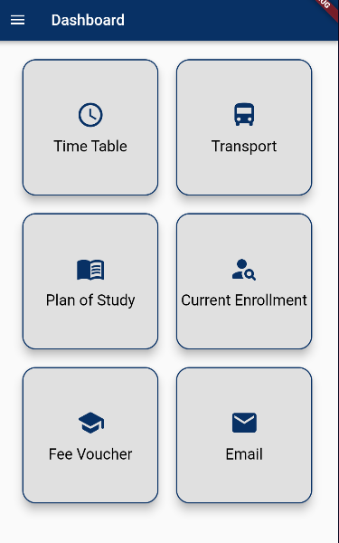
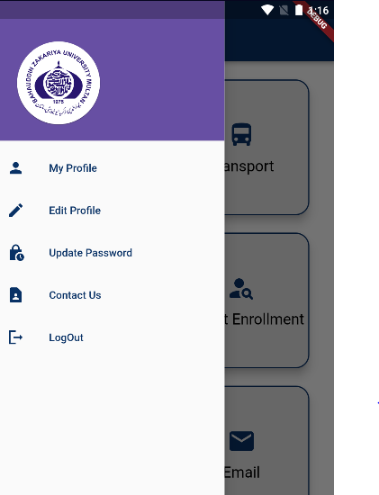
User’s Dashboard

Slide 14
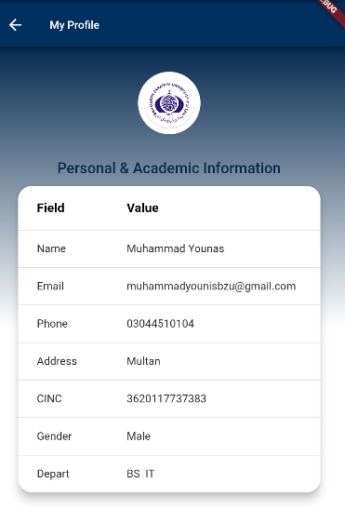
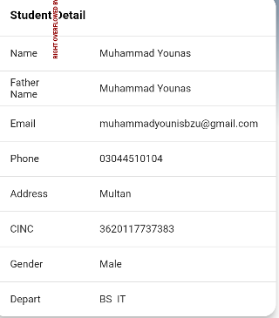
My Profile

Slide 15
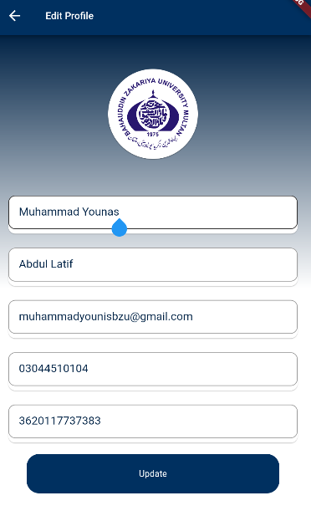
Edit Profile

Slide 16
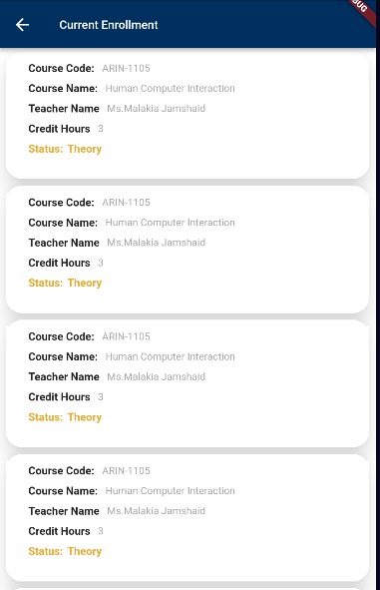
Current Enrollments

Slide 17
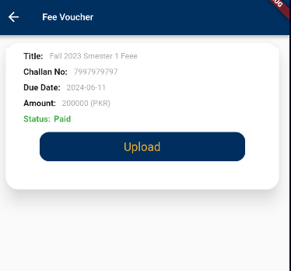
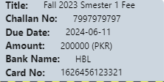
Fee Voucher

Slide 18
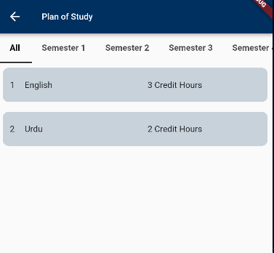
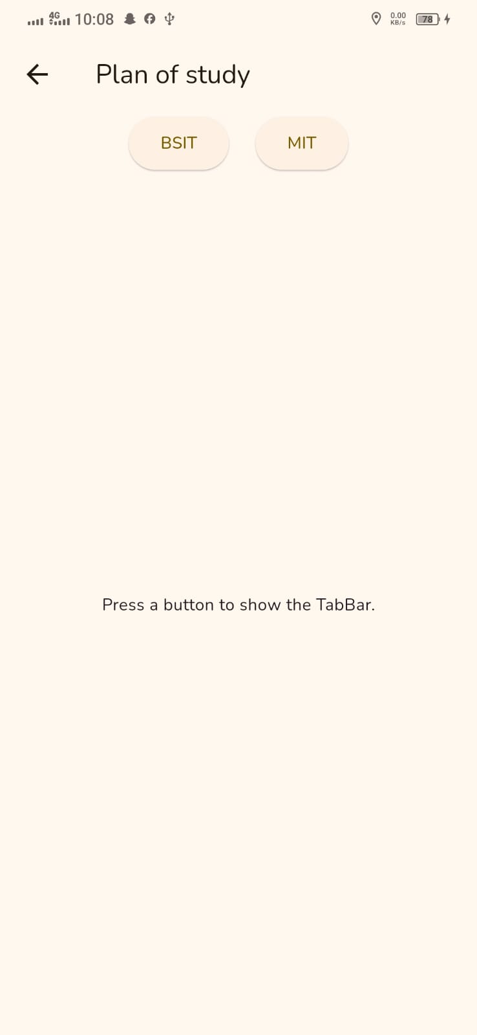
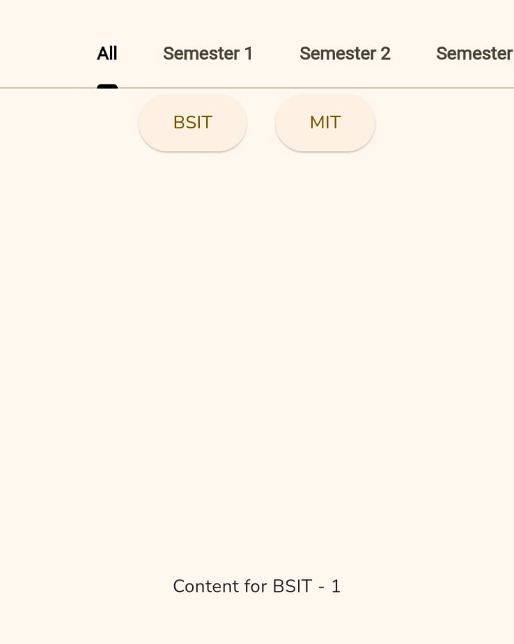
Paln of Study ( Changings)
Old
Changed
Changed

Slide 19
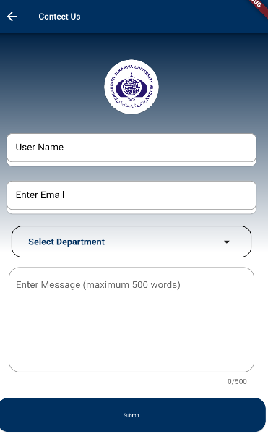
Contact Us

Slide 20
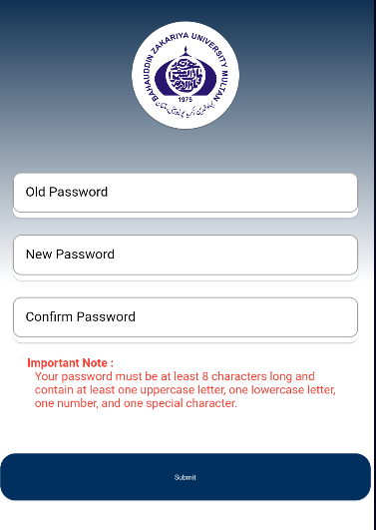
Update Password

Slide 21
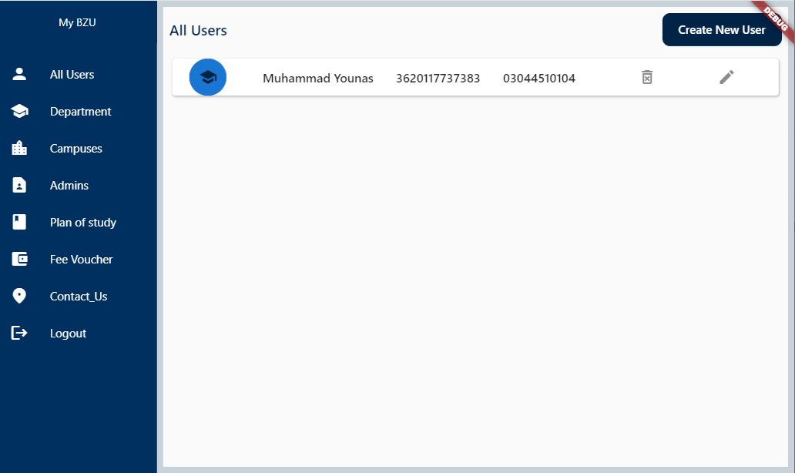
Admin Panel

Slide 22
Conclusion
In conclusion, the Learning Management System offers a user-friendly solution for managing educational resources and facilitating effective learning experiences. This comprehensive platform, developed using modern technologies like Flutter, provides essential features such as course management, user authentication, and content access control. It empowers educators to create engaging courses and enables learners to access educational materials easily.

Slide 23


